Slide 1
Relational Database Management System
RDBMS

Slide 2
SQLite Types
Text
Numeric
Integer
Real
Blob

Slide 3
MySql Types
CHAR (Size)
VARCHAR(Size)
SMALLINT
INT
BIGINT
FLOAT
DOUBLE

Slide 4
SQL COMMADS
CREATE A NEW TABLE
CREATE TABLE flights(
id INTEGER PRIMARY KEY AUTOINCREMENT UNIQUE,
origin TEXT NOT NULL,
destination TEXT NOT NULL,
duration INTEGER NOT NULL

Slide 5
INERTING DATA INTO TABLE
INSERT INTO flights
(origin, destination, duration)
VALUES (“New York”, “London”, 415);
GETTING DATA FROM TABLE
SELECT * from flights
// Select every and columns in table flights
SELECT origin, destination from flights
// Select every rows with origin and destination columns in table flights

Slide 6
SELECT * from flights WHERE id = 3
// Select every rows with all columns in table flights whose id is equal 3
SELECT * from flights WHERE origin = “New York”
// Select every rows all columns in table flights whose origin is new york

Slide 7
CREATING SQLITE DATABASE
Install SQLITE
> touch flights.sql
>sqlite3 flights.sql
Sqlite> CREATE TABLE flights (
...> id INTEGER PRIMARY KEY AUTOINCREMENT,
...> origin TEXT NOT NULL,
...> destination TEXT NOT NULL,
...> duration INTEGER NOT NULL
...> );
Sqlite> .tables
Sqlite> .mode columns
Sqlite> INSERT INTO flights (origin, destination, duration) VALUES ("Raipur", "Goa", 2);

Slide 8
Sqlite> SELECT * FROM flights
SELECT * FROM flights WHERE duration>10;
SELECT origin FROM flights WHERE destination = "raipur";
UPDATE flights
...> SET origin = "kanker", destination = 'delhi'
...> WHERE id = 3;
SELECT * FROM flights WHERE id = 3
SELECT * FROM flights WHERE origin LIKE "%K%";

Slide 9
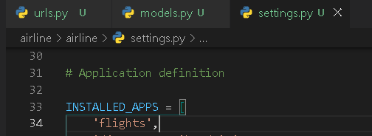
Airline Project
> django-admin startproject airline
> cd airline
> python manage.py startapp flights
Updating the settings file -

Slide 10
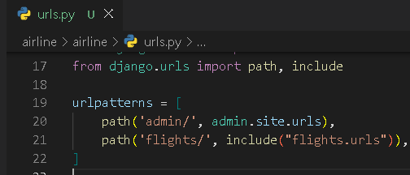
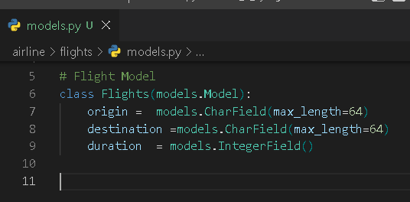
Updating the url file inside airline project-
Creating a flight model

Slide 11
> python manage.py makemigrations
> python manage.py migrate
To Access the python shell
> pyhton manage.py shell
>> from flights.models import *
>> skr = Airport(code=“rpr”, city = “Raipur”)
>> skr.save();
>> skr = Airport(code=“rpr”, city = “Raipur”)
>> skr.save();

Slide 12
To Access the python shell
> pyhton manage.py shell
>> from flights.models import *
>> lrt = Airport(code="RPR", city="Raipur");
>> ltr.save()
>> alldata = Airports.objects.all()
>> singleData= alldata.first()
>> singleData.delete()

Slide 13
Filter
>> Airports.objects.filter(city=“jagdalpur”)
>> Airports.objects.filter(city=“jagdalpur”).first()
>> Airports.objects.get(city=“jagdalpur”)

Slide 14
ADMIN APP
Create Admin Accont
> python manage.py createsuperuser
>email
> password
> Password (again)

